Slide 1
Welcome to COM 318

Slide 2
Today’s Class
Instructor Introductions
Go over syllabus, including:
Required readings
Course policies
Class assignments
Important information about how to get an “A.”

Slide 3

Lisa Guntzviller (last names A-G)
Education
B.A. Communication/Math, Aquinas College
M.A. Communication, Purdue
Last year of Ph.D. in Communication
Research Interests
Language Brokering
Doctor-Patient Relationships
Advice
Fun Facts
Worked as a scary clown in a haunted corn maze
Is not recognized without her glasses
Has a laugh that sounds like a donkey

Slide 4
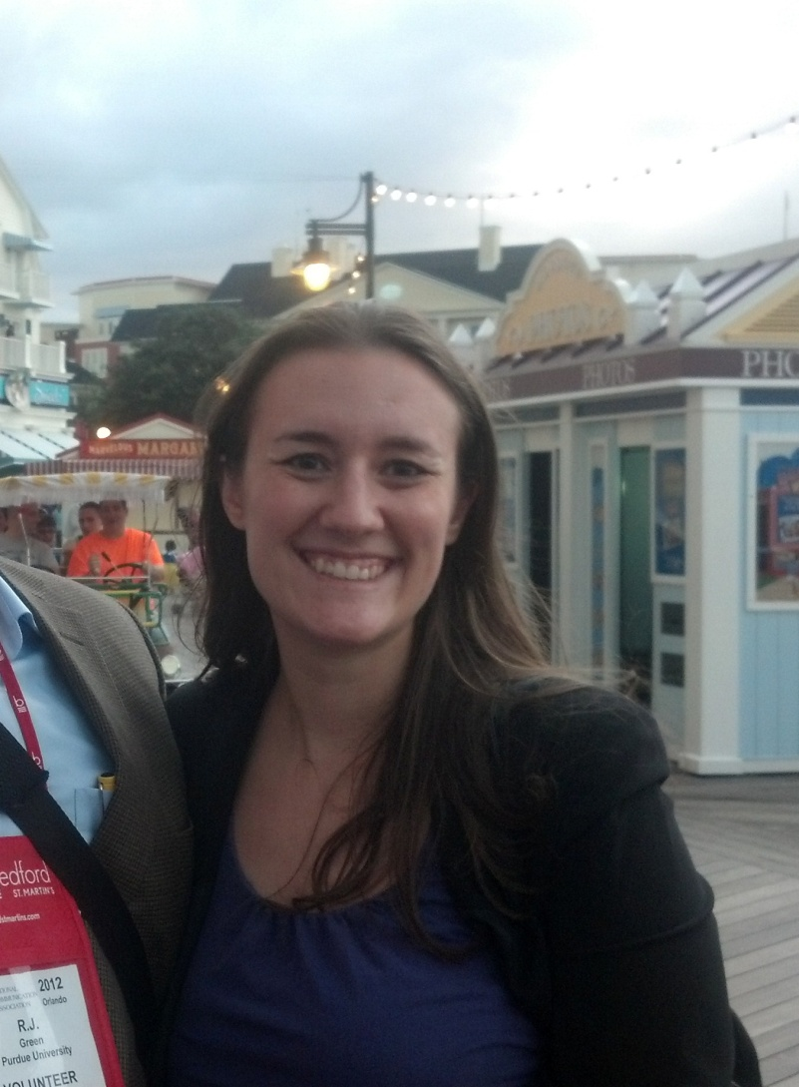
Paula Hopeck (last names H-O)
Education
B.A. Communication Studies and History, Canisius College
M.A. Communication, Purdue
PhD Candidate
Research Interests
Organizational Communication
Conflict & Procedural Justice
Organizational Policy
Health Communication
Fun Facts
Also a TA for COM 102
Took piano lessons for eight years growing up…and has retained nothing

Slide 5
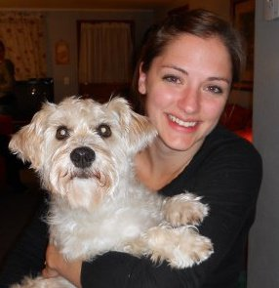

Courtney Scherr (last names P-Z)
Education
B.A. Communication Arts & B.A. International Studies, University of Wisconsin - Madison
M.A. Communication, University of Wisconsin - Milwaukee
Currently a Ph.D. candidate, Purdue University
Research Interests
Health Communication
Communication of Risk
Cancer Communication and Prevention
Interesting Facts
Live near Indianapolis – have become an NPR junkie!
Original career goal was to be an Indy car driver.
Studied abroad in Ireland, and hope to return soon!

Slide 6
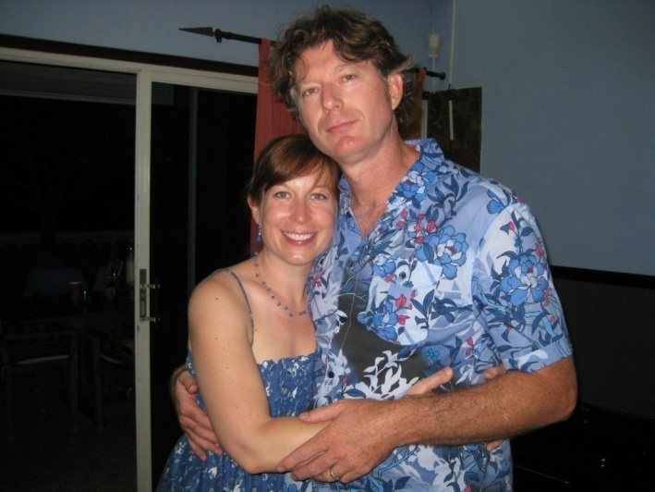
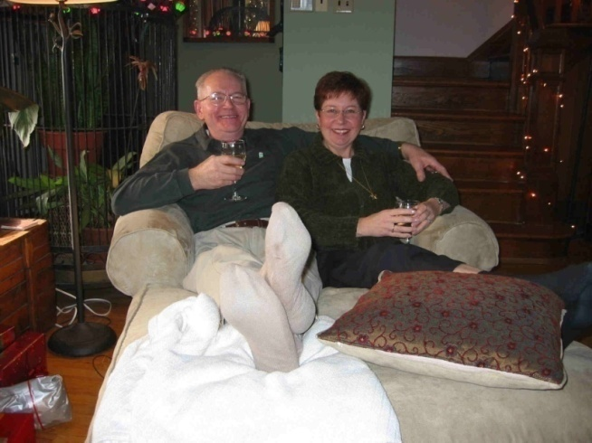
Dr. Susan E. Morgan (Your Professor)
Education/Background
B.A. Communication, U of Massachusetts; MA & Ph.D., U of Arizona.
Assistant Professor, U of Kentucky (1996- 2001); Associate Professor, Rutgers U (2001- 2005); Professor, Purdue (2005- present)
Research Interests
The design and evaluation of health campaigns
Message design
Intercultural communication
Fun Facts
$9+M in federally funding, 50 publications, 1 book, 50 conference papers and presentations… and yet watches America’s Next Top Model.
Is married to Dr. Harrison (teaching COM 102) but is neither Mrs. Harrison nor Mrs. Morgan!
Is glad her father changed their last name from “Mochnacs” but is still close to her Hungarian family.

Slide 7

WARNING!
This class is Rated R (For Mature Audiences Only)
If you watch cable television or go to R-rated movies, you can handle the language used in class, including lectures and video clips.

Slide 8
COM 318 Syllabus
PLEASE NOTE: You are responsible for knowing all information contained in this syllabus. Consult this document before emailing the instructors about whether or not a class policy exists, exam dates or deadlines.

Slide 9
Information about Instructors
Instructor: Dr. Susan E. Morgan
Office: Beering 2274G
Dr. Morgan’s office hours: Tuesdays and Thursdays 1:30-2:30 pm, and by appointment
Email addresses, office hours and contact information (contact your TAs with basic questions first):
Students with last names beginning with A-G: Lisa Guntzviller (BRNG 2167, T 10-12 + by appt.): lguntzviller@purdue.edu
Students with last names beginning with H-O: Paula Hopeck (BRNG 2263, T 9-11; Th 10:30-11:30): phopeck@purdue.edu
Students with last names beginning with P-Z: Courtney Scherr (BRNG 2274B, T 4:30-6:00): clynam@purdue.edu
Dr. Morgan’s email: semorgan@purdue.edu
Website: susanemorgan.com

Slide 10
Who Should You Email About Your Questions?
Email your TA with questions about grades, lecture materials/outlines, exams, assignment requirements, attendance.
Email Dr. Morgan to make an appointment to discuss questions about lecture content, theories of persuasion, problems with your TA, career aspirations & trajectories, coursework strategies to attain career goals, cool and interesting thoughts and ideas.
If you have to miss class, you can find out “if you missed anything important” by checking Blackboard Learn for any announcements. All Powerpoint slide content will be posted the day before class. (Do feel free to email us to tell us how sad you are to have been forced to miss such a terrific class– but no need to ask us “if you missed anything.”)

Slide 11
Course Overview
Communication 318 is designed to be an exploration of the theories of social influence which guide much of today’s communication research. This class will encourage interaction and exchange between class members; this means that you will be required to keep up with the readings so that you will be able to participate in class discussions.
The sum of what you learn in this class may be one of the ultimate cases of “news you can use.” Not only are you subjected to hundreds of attempts at influence every day (in the form of commercials, billboards, print ads, etc.), but you will be expected throughout your life to be competent at persuading others (in business meetings or job interviews, for example). In this class, you will learn what makes an attempt at persuasion successful and how to resist being persuaded when you choose.

Slide 12
Course Objectives
1. To learn about the major areas of study in the field of persuasion.
2. To provide opportunities for the analysis of persuasive techniques.
3. To understand how theories of persuasion can aid the comprehension of everyday circumstances.

Slide 13


Required Readings
Cialdini, R. B. (2009). Influence: Science and Practice, 5th Edition. New York: Harper Collins.
Gass, R.H. & Seiter, J.S. (2010). Persuasion, Social Influence, and Compliance Gaining, 4^{rh} Edition. Allyn & Bacon.

Slide 14
Course Requirements
Two (non-cumulative) out of three exams (100 points each): 200 points (33.3% of your grade; total 66.6% of grade)
Mini-paper: 50 points (16.7% of your grade)
Activities and civility: 50 points (16.7% of your grade)
TOTAL: 300 points
Final Grades: The +/- system will divide the number of points according to the following pattern: 97% - 100% = A+, 93%-96.9% = A, 90% - 92.9% = A-; 87 % - 89.9% = B+, 83% - 86.9% = B, 80% - 82.9% = B-, and so on.)

Slide 15
Course Policies
Academic Integrity: The student handbook provides clear guidelines on what constitutes academic integrity:
3.2 Cheating
Cheating is defined by its general usage. It includes, but is not limited to, the wrongful giving, taking, or presenting any information or material by a student with the intent of aiding him/herself or another on any academic work which is considered in any way in the determination of the final grade. Any question of definition shall be referred to the University Appeals Board.
The sanction of punishment for a student who is accused of either plagiarizing or cheating is a minimum of an F grade for the entire course, but it may involve suspension, dismissal, or expulsion from the University. As you can see, these are serious measures for academic offenses which we believe are serious. If you have any questions about whether you may be committing either of these academic offenses, be sure to contact your instructor.
INSTRUCTOR NOTE: In addition to not plagiarizing from outside sources, you may not turn in a paper (in whole or in part) that you have written for another class. This is self-plagiarism, which is considered an act of academic dishonesty. As such, self-plagiarism will result in a score of zero for an assignment. Any paper that is flagged by Safe Assign as having plagiarized material will be penalized severely as follows: Over 30% = failing grade for the paper, the course and possible sanctions by the Dean of Students Office, depending on the severity of the offense. Over 10% but under 30% plagiarized material will receive a point penalty equal to the percentage of material flagged by Safe Assign.

Slide 16
Course Policies, continued
Make-up Policies and Emergencies
Class attendance is NOT required. If you are absent from class for whatever reason, however, YOU are responsible for all material covered in lecture. This means if you want to get notes for a missed class (beyond what is posted in Blackboard) you must get them from a friend or classmate. There are no opportunities to make up exams for any reason. Anyone can miss any one exam for any reason. Only students with TWO documented medical emergencies (e.g. hospitalizations) or grief-related absences verified by the Dean of Students Office will be permitted to make up an exam. See http://www.purdue.edu/odos/services/griefabsencepolicyforstudents.php.

Slide 17
THIS PARAGRAPH IS REALLY IMPORTANT
This class is offered every semester, and the dates of all exams and assignments are provided in this syllabus. There will be no make-up exams or assignments given. As such, I recommend that if you cannot take exams on certain days or turn in assignments at the provided deadlines that you drop the class and take it during a future semester when your schedule clears up (Alternately, you could elect to take the online section of this class). Notes or excuses from a doctor, a coach, a family member, etc. will not be accepted.
This may seem harsh, but because of the size of this class there will be no exceptions to this policy. If you think you will only miss one exam, however, you can still do so, as you will be taking three exams over the course of the semester and your top two scores will be used in the calculation of your grade. Thus, you can miss one exam–but doing so means you would need to do well on the two other exams. Please do not elect to miss either of the first two exams because you don’t feel fully prepared. If you do not take one of the first two exams and then find that you must miss the third exam due to a serious illness or genuine emergency, you will NOT be able to make up the exam and your grade will be based on having taken only one exam. In addition to the exams, the other major assignment is a mini-paper. There is a one-grade deduction for late papers that are uploaded after the start of class. For each additional day the paper is late, there will be an additional one-grade deduction.

Slide 18
In event of a campus emergency...
In the event of a major campus emergency, course requirements, deadlines and grading percentages are subject to changes that may be necessitated by a revised semester calendar or other circumstances beyond the instructor’s control. Additionally, please contact your TA ASAP if you require any additional accommodations for completing exams or assignments if there is a campus emergency.

Slide 19
Extra Credit
The Department of Communication is now using an online program that expedites the process of recruiting, signing up, and granting extra credit to students for participating in research studies. The program is called the Research Participation System, and it provides an easy online method for you to sign up for research studies, to keep track of the studies you have completed, and to view how many credits you have earned for each study. You can access the system online at any time, from any computer with a standard web browser. By participating in studies done within the Department of Communication, you can learn first- hand how a study is conducted, you can contribute to the advancement of the field, and you can improve your grade by earning extra credit. Here are the details:
You earn a ½ percent credit for every half-hour that you participate in a study. The maximum percent that you can earn for this course is 2%, which will be added to your total course points (300). For example, student A participates in:
2 studies (30 minutes each) and receives ½% credit for each study for a total of 1%
2 studies (60 minutes each) and receives 1% credit for each study for a total of 2%
If you sign up to participate in a study and fail to show up without canceling your appointment in advance (up to 2 hours before the study), you will be automatically restricted from signing up for any studies for 30 days. You may quickly cancel your appointment online using the Research Participation System.
Please review the instructions before you sign up for studies; to view the instructions go to http://www.cla.purdue.edu/communication/undergraduate/rps.shtml
You can sign up to participate in studies by logging in to http://purdue-comm.sona-systems.com/.
At the end of the semester, the instructors will receive a list of every student who has participated in extra credit studies and the amount of extra credit they have earned. You do not have to email us to notify us you have done extra credit.
If you are unsure whether you have received proper credit for participating in a study, you must email the researcher who is in charge of the study. The research participation system is completely separate from all class activities and administration. We cannot mediate disputes about whether or not you have fully completed a study, how much extra credit you earned, etc.

Slide 20
Activity/Civility Points
Class attendance is NOT required. As such, if you want to read the newspaper, drink alcohol, chew tobacco, sleep, or chat with your friends (all of which have, yes, happened in class on multiple occasions)—there’s not much point to being in class. Walk to the Student Union, find a nice, comfortable spot and do whatever you like.

Slide 21
Activity: 5 point quiz
To mitigate the problem of covering material in the syllabus over and over in class, there will be a 5-point quiz on the syllabus on Thursday, 1/17/13. Although you do not need to memorize the syllabus, you do need to know the types of things that are the most bothersome to (virtually all of!) your instructors:
Who I am
Who your TA is
How many exams there are
Whether exams are cumulative
What types of questions will be asked on the exam
Whether attendance is required
Classroom technology policy
Whether extra credit is awarded (and how you can get extra credit)
Whether you can copy from your own paper from another class and turn it in for this class
How you can appeal an exam or paper grade

Slide 22
Remainder of Civility Points
The remainder of the points will be dedicated to in-class or take-home activities and to reward students who do not violate guidelines for civil behavior and communication with COM 318 staff members. (We will, of course, adhere to these guidelines in all of our communication and behavior with you.) Naturally, I assume that you were raised to have good manners and that you all understand the importance of being polite to those who are working hard to provide you with the best educational experience possible. However, experience has taught me that I cannot take this for granted which means that I intend to reward people who do not make the work of COM 318 staff more difficult than it has to be.
You will lose 15 points (half a letter grade), at our discretion, EACH TIME you violate any of the following:
You use a laptop computer or cell phone or any other form of technology in class without prior permission and without sitting in the back row.
You refuse to comply with a request made by any member of the staff or exam proctors.
You yell at any member of the staff, exam proctors, or fellow students.
You use profanity or call anyone names.
You communicate disrespectfully (by being snarky, insulting, sarcastic, etc.).
You engage in blatantly manipulative or coercive behavior (including lying).
You make an appointment with a TA or me and fail to show up without contacting us in advance. Our time is valuable and there are nearly 400 students in the class who need our attention.

Slide 23
Communication with COM 318 Professor & TAs
You have already been assigned a TA for this class (see the first page of this document). Direct all of your questions about class to your designated TA first. You can expect to receive a response within 24 hours (Monday-Friday). Your TA may elect to copy me on a response to your email to “keep me in the loop.” If you have an issue or concern about your TA, please email me.
Regardless of whether you agree with a grade or whether you are frustrated by the difficulty of an exam or any other issue, you must behave professionally at all times, per Purdue’s statement of Student Rights and Responsibilities (which can be found on Purdue’s webpage). When communicating with me or the TAs (or exam proctors), you will follow the usual standards that you will be held to when you graduate and are working in a professional capacity:
When emailing, please use proper grammar, spelling, and punctuation. Do not use forms of spelling that are commonly accepted when texting with your friends. Unlike your friends, we do judge your intelligence and your level of dedication to your academic pursuits by the way you communicate.
When emailing, introduce yourself as a COM 318 student and provide your name. The TAs teach other classes in addition to 318 and they need to know which class you are referencing.
When emailing OR in person, you will demonstrate basic common courtesy and adhere to accepted norms of politeness. Treat the COM 318 staff as though they are your supervisors at a professional job.
If you engage in highly uncivil behaviors, you will be in violation of workplace harassment guidelines. Just as students have rights that are taken very seriously, all employees of the university have the right to work in a non-hostile environment. If you engage in hostile and unprofessional behavior, you will be reported to the Dean of Students Office and charges may be filed against you that may result in serious disciplinary action.

Slide 24
Technology Policy
The notes for class will be posted online the night before class. You may print these Powerpoint notes and bring them to class. Therefore, no laptops are needed in class. The classroom is an educational environment. Learning is not supported by the use of technology for entertainment purposes. If there is something urgent happening in your life (like the illness of a loved one), you may ask YOUR TA BEFORE THE START OF CLASS for permission to sit in the back row of the classroom. However, any activity deemed disruptive by the TAs (such as talking) must cease immediately upon request of a TA or you will face the loss of civility points.
If you decide to ignore this policy by texting, talking, etc., a TA will ask you to stop this activity immediately AND will ask you for your name and Purdue ID number. We have a no-tolerance policy for violations. You will lose 15 points (5% of your final grade) for each violation of our technology policy. No “warnings” will be issued in advance of loss of points because this only adds to the disruptions in your classmates’ ability to concentrate on class. If you register your objection to the enforcement this policy by being disrespectful (verbally or nonverbally) including arguing with me or the TAs, stomping out of class, slamming the door, or disrupting other students by deliberately jostling them or allowing your backpack to hit others as you leave, you will be asked to leave class for the remainder of that day and you will lose an additional 15 points IN ADDITION TO being reported to the Dean of Students Office for violations of the Student Code of Conduct. If you choose to violate course policy on technology and are caught, the only acceptable response is a simple, quiet apology, and providing the TA with your name and Purdue ID number (or Purdue ID card) .This policy is in place to allow other students attending class to devote their full attention to course content without the distraction of other students’ activities or activities related to the enforcement of this policy.

Slide 25
If You MUST Get an A or B...
If you need an A (or B) in the class in order to get into the Communication major or to raise your GPA for whatever reason, I would suggest to you that you should have done better in your other courses so you didn’t have this grade pressure. If your parents will be terribly disappointed in you if you bring home less than a B (or fail to pass the class, etc.), I would strongly suggest that you take all of the assignments seriously rather than resorting to begging me or the TAs for extra points, additional extra credit opportunities, etc.
Here is my best advice for how to get a good grade in this class:
If you have writing issues, go to the writing center and get help with organization, editing, proofreading, and general writing to ensure you get the best possible grade on the mini-paper. Follow all of the criteria for the paper requirements to the letter and talk to your TA if you don’t understand any part of the assignment.
Study hard for ALL of the exams. Studying with another student(s) who is serious about doing well on the exams is often a good strategy.
Attend all classes (unless you are genuinely ill and cannot responsibly come to lecture) and pay attention by eliminating your distractions via internet, text, and email. If you do not come to class, you will miss material that will be on the exam, particularly any material that is not presented in the PowerPoint outlines of lecture.
Keep up with course readings. You will learn the material easier and will do better on exams if you come to lecture well-prepared for a more in-depth review of the principles covered in the texts.
Be professional and civil in all of your communication with your fellow students, me, and all of the TAs.
Take advantage of the extra credit research opportunities well in advance of the end of the semester. At the end of the semester, many students are desperate to raise their grades a few points and studies will be full, meaning that you will not be able to do any extra credit. I will NOT offer you any additional extra credit opportunities. Extra credit is not a “right”—it is a generous bonus that I have offered to you as an option for you to either do or not do, as you choose.
Finally, do not assume that because this is a communication class, it will be an easy course. You will be very disappointed at the end of the semester when you receive your final grade.

Slide 26
Course Assignments: Exams
Exams will be multiple-choice and are likely to consist of 33-40 questions each. There are three exams but only your top two scores will be counted. THERE WILL BE NO MAKE-UP EXAMS FOR ANY REASON WHATSOEVER. If you miss an exam, your scores from the other two exams will be used. If you take the first two exams and you are happy with your grade, you may elect to skip the third exam. If something truly catastrophic happens and you must miss two of the three exams, you must provide full documentation for the reasons why it was impossible for you to take BOTH exams in order for you to be able to make up one exam. Both absences must be documented as true, unavoidable emergencies.
Questions are never designed to be “trick” questions. However, to do well on exams, you will likely need to attend class regularly and read all of the assigned material in time for class. Cramming rarely works (at least not for the exams I write). If you wish to contest a specific question on an exam, you must submit your appeal in writing to your TA within 3 days of the return of exam scores. You must cite evidence for why your answer is correct. Use principles of persuasion when making your appeal!

Slide 27
Course Assignments: Mini-Paper
Mini Paper (50 points, 3-4 pages double-spaced)
Describe a principle of persuasion. Do not just state which principle or theory you are using. Use only one theory. You must demonstrate a thorough understanding of it by describing it in detail.
Cite at least 3 scholarly sources for the information you use in your paper using APA format.
Describe what you did to put this principle of persuasion into practice. This part of your paper should be no more than one full page.
Evaluate the success of your attempt. Describe why it did or did not work, according to the theory/principle.
Write no more than 4 pages and no less than 3 full pages of text in APA format (extra spacing and headers will be removed). Write them well.
Your paper MUST be well-written and well-organized and adhere to the assignment requirements in order to receive a good grade. You must demonstrate good writing skills as well as a solid understanding of the concepts covered in class. Emailed papers will NOT BE ACCEPTED. You must turn in your paper via Blackboard/Safe Assign. If your paper is late, you will lose one letter grade for each day that it is late, beginning 5 minutes after the start of class. Again, emailed papers will not be accepted.
If you do not agree with your grade and would like to appeal you must provide the appeal to your TA in writing and submit it within three days after the return of your paper. Because this is a class in persuasion, telling us that you worked hard on the paper and “deserve” (or “need”) a better grade will be a highly ineffective appeal. If, however, a TA deducts points from your grade because you inaccurately described a principle or theory of persuasion and you believe that you did it correctly, in your written appeal you should reference the appropriate textbook and page number or the date of class lecture on which you based your description.

Slide 28
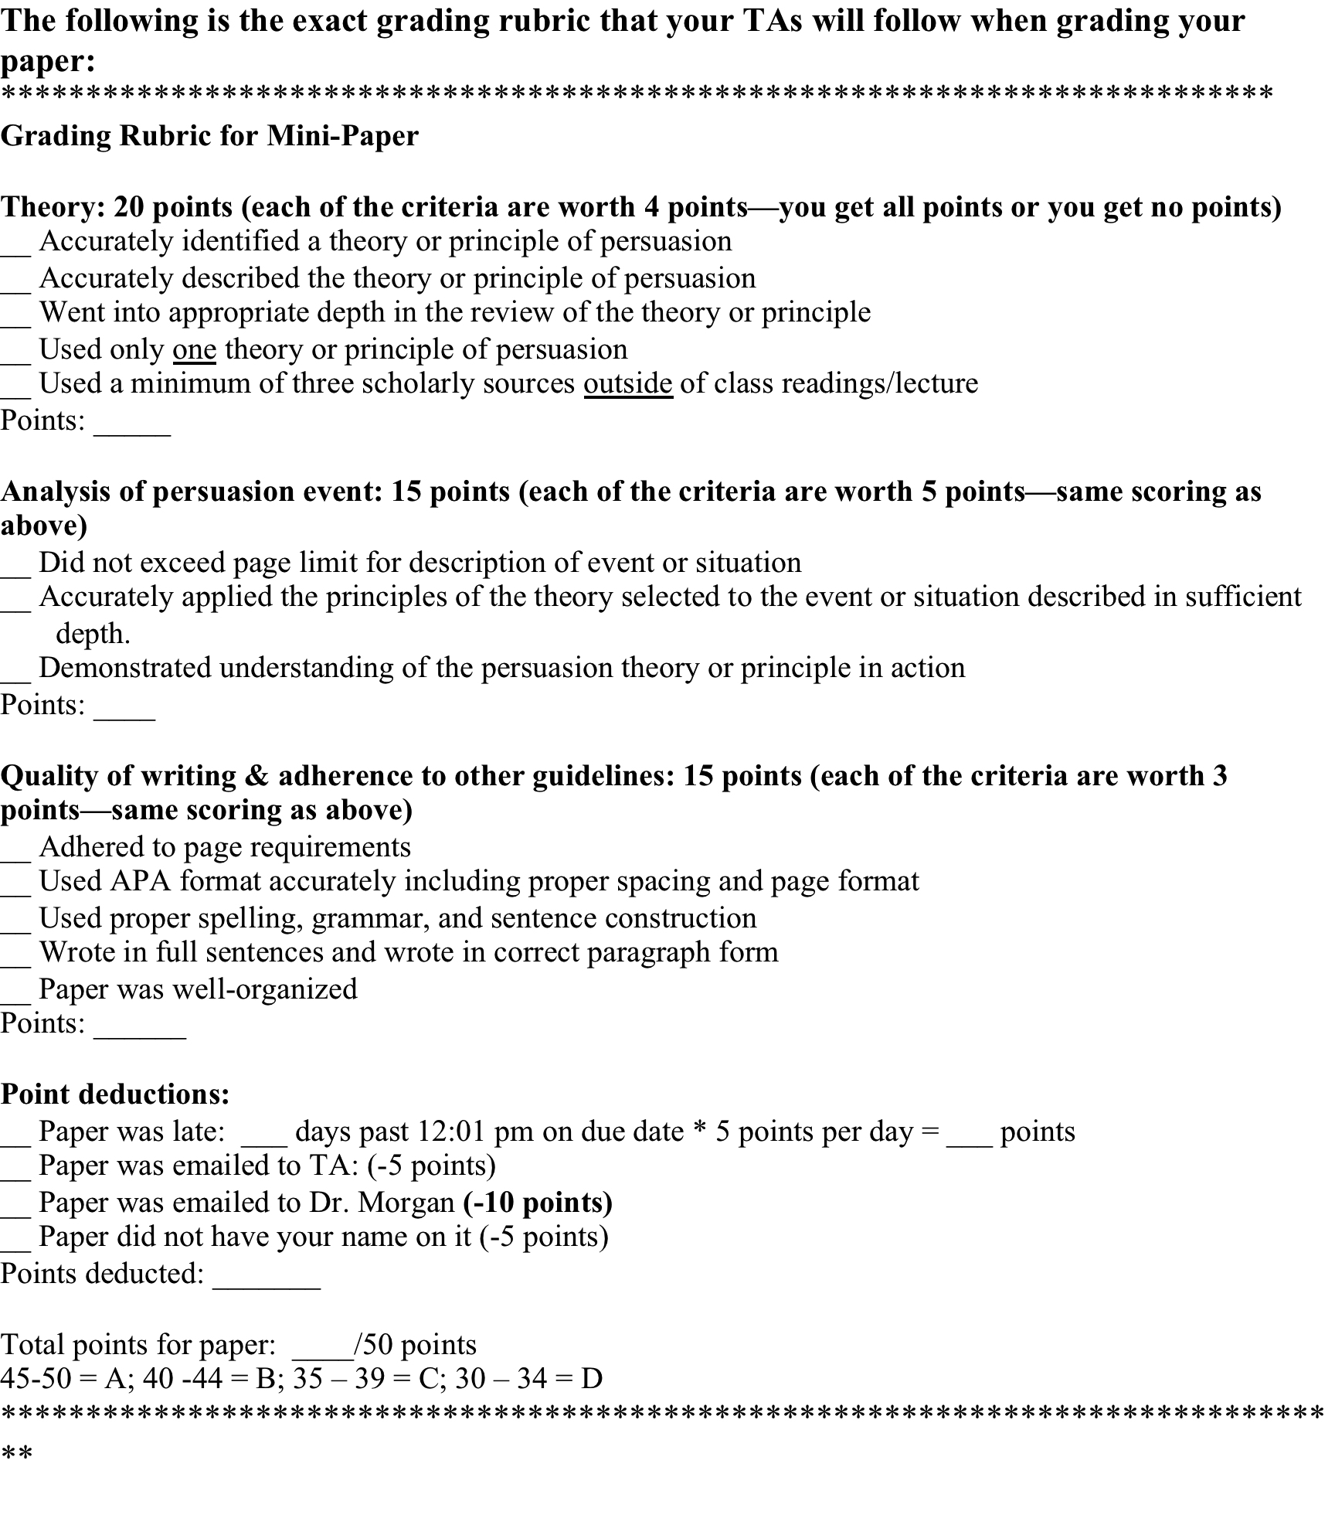

Slide 29
Questions?

